Slide 1
Machine Learning Based Heart Failure Prediction System
Team Members –
Aditya Raj (2821250)
Vishal (2821238)
Hardik (2821194)
Soham (2821103)
Project Supervisor
Dr. Navneet Verma Sir

Slide 2
PROJECT OVERVIEW
This research endeavours to construct a reliable decision-support system for predicting the survival of heart failure patients by leveraging their clinical records and laboratory test results. Employing machine learning techniques, the study aims to identify significant factors for survival prediction and develop an accurate algorithm. The dataset comprises medical records of 899 heart failure patients from the real time dataset.

Slide 3
PROBLEM STATEMENT
Heart failure (HF) remains a leading cause of mortality globally, necessitating timely and accurate prediction of patient survival. Existing methods for forecasting Heart Failure related events often lack precision and consistency, hindering effective patient management. This study addresses the need for a dependable decision-support system capable of accurately predicting survival outcomes for Heart Failure patients, utilizing machine learning approaches and comprehensive patient data.

Slide 4
METHODOLOGY
Dataset collection
Data Preprocessing and Normalization
Data Imputation
Data Visualization
Model Development
Evaluation Matrices
Result and Impact
Future Direction and Conclusion

Slide 5
LIBRARIES and TOOLS
Pandas
NumPy
Matplotlib
Seaborn
SciPy
SkLearn

Slide 6
STRUCTURE OF DATASET
Features | Explanation | Measurement | Range
Age | Age of the patient | Years | (40-95)
Anaemia | Decrease of red blood cells or hemoglobin | Binary | 0,1
High BP | If a patient has hypertension | Binary | 0,1
Creatinine phosphokinase | Level of the CPK enzyme in the blood | mcg/L | (23,… 786)
Diabetes | If the patient has diabetes | Binary | 0,1
Ejection fraction | Percentage of blood leaving the heart at each contraction | Percentage | (14,…80)
Sex | Woman or man | Binary | 0,1
Platelets | Platelets in the blood | kiloplatelets/mL | (25.01,….850.00)
Serum creatinine | Level of creatinine in the blood | mg/dL | 0.50,……9.40
Serum sodium | Level of sodium in the blood | mEq/L | 114,….148
Smoking | If the patient smokes | Binary | 0,1
Time | Follow-up period | Days | 4,….385
(target) death event | If the patient died during the follow-up period | Binary | 0,1

Slide 7
DATASET PREPROCESSING AND NORMALIZATION

Slide 8
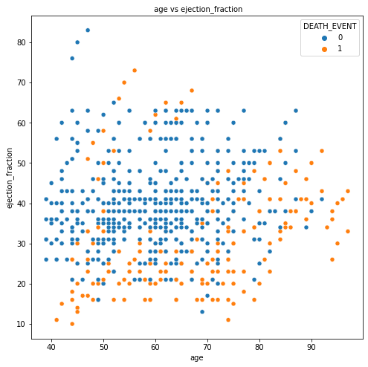
As part of the dataset verification process, we plotted scatter graphs to visualize the relationship between age and ejection fraction attributes compared to the outcome (presence or absence of heart disease). This step allowed us to inspect the data for any anomalies or inconsistencies that could affect the performance of our predictive model.
Scattered Graph

Slide 9
Normalization Process
After verifying the dataset, we proceeded with the normalization process. Normalization is essential to bring all attributes to the same scale, which helps improve the convergence speed of machine learning algorithms and ensures fair treatment of all features during model training.
In our normalization process, we first calculated the skewness in the data to identify any non-normal distributions. Skewness indicates the asymmetry of the distribution of values in a dataset. Based on the skewness calculations, we applied different transformations to normalize the data, such as square root or cube root transformations, to mitigate skewness and achieve a more balanced distribution. By addressing skewness before normalization, we ensured that the data was transformed appropriately to enhance the performance of the machine learning algorithms.

Slide 10
skewness
Before Transformation |  | After Transformation
age | 0.416285 | age | 0.416285
anemia | 0.277327 | anemia | 0.277327
creatinine_phosphokinase | 4.448100 | creatinine_phosphokinase | 1.433947
diabetes | 0.332808 | diabetes | 0.332808
ejection_fraction | 0.505713 | ejection_fraction | 0.505713
high_blood_pressure | 0.624628 | high_blood_pressure | 0.624628
platelets | 1.455199 | platelets | 1.455199
serum_creatinine | 3.606436 | serum_creatinine | 1.950525
serum_sodium | -0.882705 | serum_sodium | -0.882705
sex | -0.624628 | sex | -0.624628
smoking | 0.767763 | smoking | 0.767763
time | 0.127189 | time | 0.127189
DEATH_EVENT | 0.767763 | DEATH_EVENT | 0.767763

Slide 11
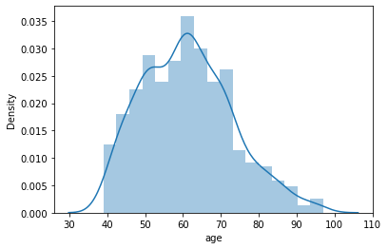
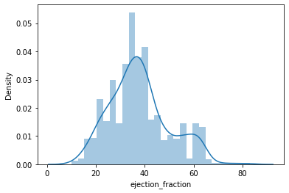
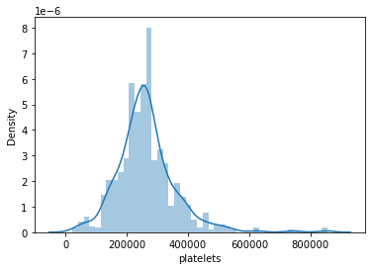
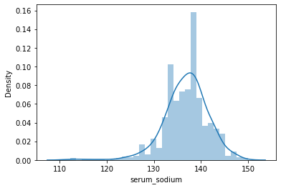
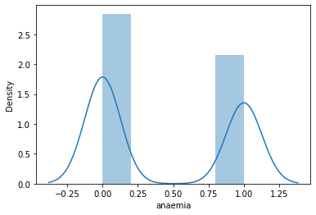
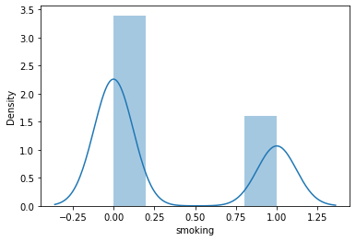
Data Visualization

Slide 12
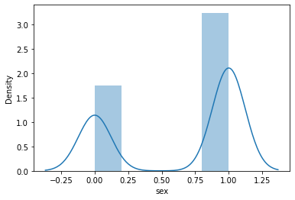
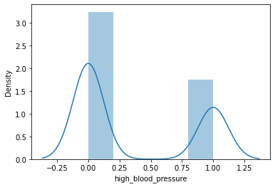
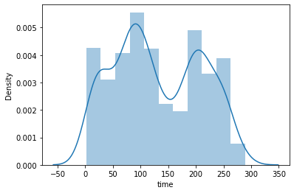
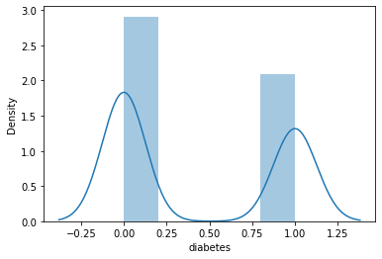

Slide 13
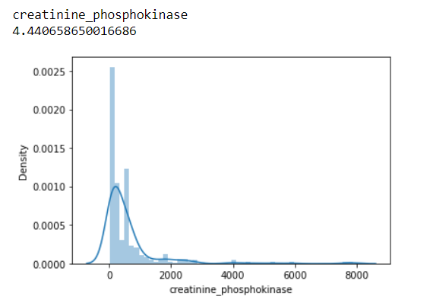
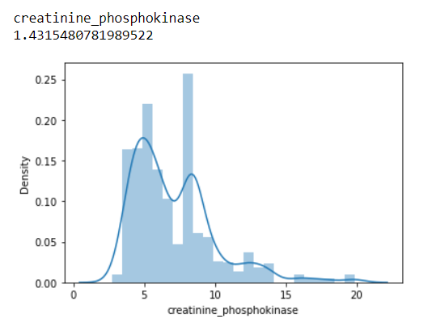
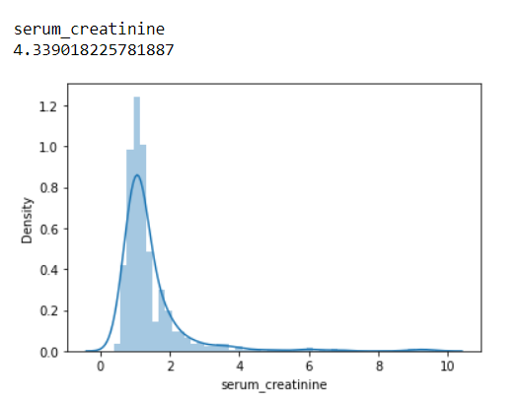
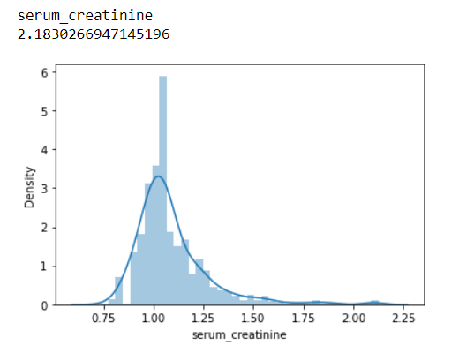
before Transformation
After Transformation

Slide 14
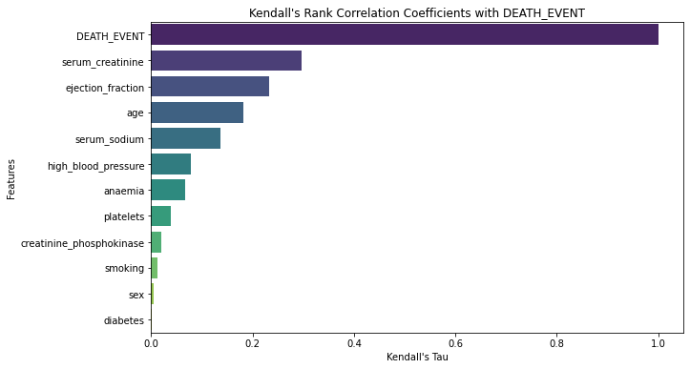
we employed Kendall's correlation coefficient to extract the best features for predicting heart disease. After applying Kendall’s Correlation Coefficient, we identified a subset of features that exhibit strong correlations with the presence or absence of Heart Disease. These Features include Serum Creatinine, Ejection Fraction, Age.
FEATURE SELECTION

Slide 15
MODEL DEVELOPMENT AND EVALUATION MATRICES

Slide 16
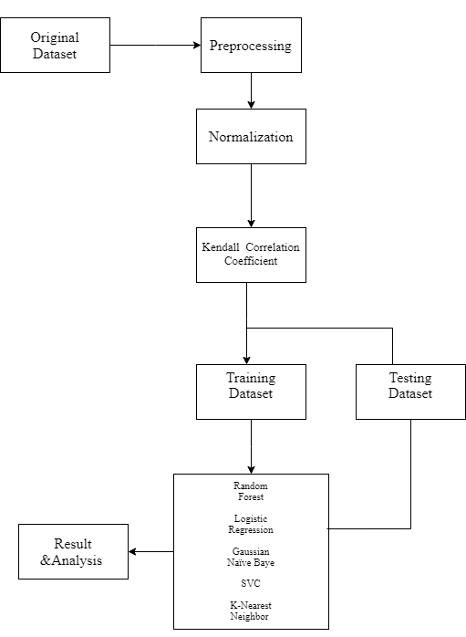
FLOW CHART

Slide 17
Algorithms
Random Forest (RF)
Logistic Regression (LR)
Gaussian Naïve Bayes (GNB)
Support Vector Classifier (SVC)
K-Nearest Neighbour (KNN)

Slide 18
Performance comparison of models developed using standard RF, LR, GNB, SVC, KNN classifiers.
 | precision | recall | F1-score | support
1. Random Forest
0 | .81 | .80 | .80 | 153
1 | .58 | .60 | .59 | 72
accuracy |  |  | .73 | 225
Macro avg | .69 | .70 | .70 | 225
Weighted avg | .74 | .73 | .73 | 225
Confusion Matrix
 | 122 | 31
 | 29 | 43
2. Logistic Regression
0 | 0.77 | 0.93 | 0.84 | 153
1 | 0.74 | 0.40 | 0.52 | 72
accuracy |  |  | 0.76 | 225
Macro avg | 0.76 | 0.67 | 0.68 | 225
Weighted avg | 0.76 | 0.76 | 0.74 | 225
Confusion Matrix
 | 143 | 10
 | 43 | 29

Slide 19
3. Gaussian Naïve Bayes
0 | 0.75 | 0.94 | 0.84 | 153
1 | 0.74 | 0.35 | 0.47 | 72
accuracy |  |  | 0.75 | 225
Macro avg | 0.74 | 0.64 | 0.65 | 225
Weighted avg | 0.75 | 0.75 | 0.72 | 225
Confusion Matrix
 | 144 | 9
 | 47 | 25
4. SVM
0 | 0.72 | .93 | 0.81 | 153
1 | 0.59 | 0.22 | 0.32 | 72
accuracy |  |  | 0.70 | 225
Macro avg | 0.65 | 0.58 | 0.57 | 225
Weighted avg | 0.68 | 0.70 | 0.65 | 225
Confusion Matrix
 | 142 | 11
 | 56 | 16
5. K-Nearest Neighbor
0 | 0.83 | 0.82 | 0.83 | 153
1 | 0.64 | 0.65 | 0.64 | 72
accuracy |  |  | 0.77 | 225
Macro avg | 0.73 | 0.74 | 0.74 | 225
Weighted avg | 0.77 | 0.77 | 0.77 | 225
Confusion Matrix
 | 126 | 27
 | 25 | 47

Slide 20
MODEL EVALUATION
To ensure the reliability and generalizability of our models, we performed k-fold cross-validation on the entire dataset. K-fold cross-validation involves splitting the dataset into k subsets (or folds), training the model on k-1 folds, and evaluating its performance on the remaining fold. This process is repeated k times, with each fold serving as the test set exactly once.
By averaging the performance metrics across all folds, we obtained a more robust estimate of each algorithm's accuracy. The results of k-fold cross-validation reaffirmed the superior performance of Random Forest, with an average accuracy of 0.7503.
This evaluation technique provides a more realistic assessment of the model's performance and helps mitigate overfitting to the training data.

Slide 21
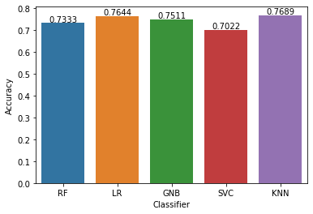
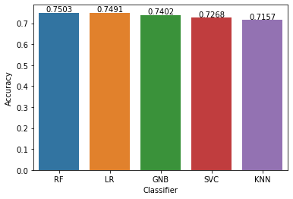
Result before K-Fold
Result After K-Fold

Slide 22
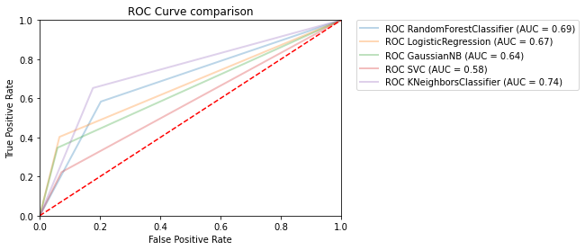
The ROC curve analysis reveals the performance differences among our models. The classifier with the highest AUC demonstrated the best discriminative ability, while others showed varying degrees of effectiveness. This comparison highlights which models are more effective in distinguishing between classes, providing valuable insights for optimizing our classification approach.

Slide 23
RESULT AND IMPACT
Random Forest algorithm emerged as the most effective model for predicting heart disease in our study, achieving an accuracy of 0.7503.
Logistic Regression (LR) maintained consistent performance with a mean accuracy of 0.7491, demonstrating its robustness in handling the dataset.
Gaussian Naïve Bayes (GNB) and Support Vector Classifier (SVC) also showed competitive mean accuracies of 0.7402 and 0.7268, respectively, after K-Fold validation.
K-Nearest Neighbor (KNN), despite having the highest accuracy before K-Fold validation, experienced a decrease in mean accuracy (0.7157) after applying K-Fold validation

Slide 24
CONCLUSION
In conclusion, the results suggest that Random Forest (RF) and Logistic Regression (LR) are the most reliable models for predicting heart disease in this study, as they consistently demonstrated high accuracy both before and after K-Fold validation.
However, Logistic Regression (LR) may have a slight advantage due to its stability and robustness in handling the dataset. Gaussian Naïve Bayes (GNB) and Support Vector Classifier (SVC) also exhibit competitive performance and could be considered as alternative models for heart disease prediction.
Hence, the Random Forest algorithm emerged as the most effective model for predicting heart disease in our study, achieving an accuracy of 0.7503.

Slide 25
FUTURE DIRECTION
1. Future Research Directions:
- Increase complexity and specificity of prediction models using advanced machine learning techniques like deep learning, ensemble learning, and causal inference methods to improve prediction accuracy and distinguish between different forms of cardiac disease.
2. Integrating Diverse Data Sources:
- Combine genetic, imaging, environmental, and social health data to gain a comprehensive understanding of heart disease risk factors and patient outcomes, enhancing the precision of predictive models.
3. IoT-Based Patient Monitoring:
- Implement IoT devices for real-time health monitoring, enabling timely interventions and personalized care, thus improving patient outcomes and optimizing resource allocation in healthcare systems.

Slide 26
THANK YOU!

